Slide 1
Programming Fundamentals
Lecture 27

Slide 2
Objectives
Storing the data from file to code variables
Special operations in a file
Writing the data in binary format
Reading/Writing objects to/from file
Writing multiple objects on the same file
Objects that write themselves
Error Handling in file streams

Slide 3

Storing the Data From File to Code Variables (1/2)
Let suppose we have some mixed data in the code and we are writing their values in the file
While writing the mixed data the individual member must be separated by a space or \n
The data shown in the figure below is written in a file
In order to read the data from file and store it in code variables the stream extraction (>>) operator is used
Have a look at the code given on next slide

Slide 4
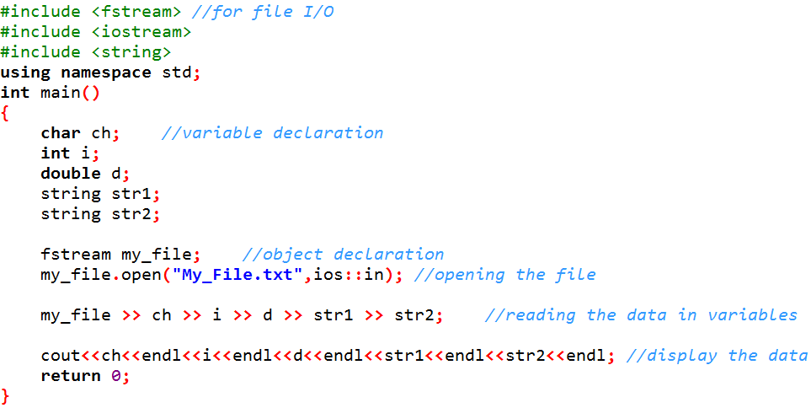
Storing the Data From File to Code Variables (2/2)
If the strings contain empty spaces then we will use getline() function to read the strings and consecutive string are separated by line break

Slide 5
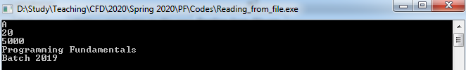
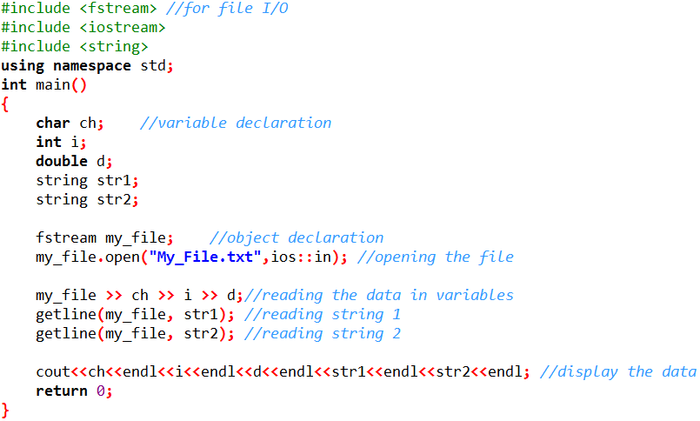

Storing the Data From File to Code Variables (Reading Empty Spaces in Strings)

Slide 6
Special Operations in a File
get position is the location of the element to be read in the next input operation
put position is the location where the next element has to be written
These positions can be observed and modified using the following member functions
  tellp() → It tells the current position of the put pointer
  tellg() → It tells the current position of the get pointer
  seekp() → It moves the put pointer to mentioned location
  seekg() → It moves the get pointer to a specified location
seekg() and seekp() functions can be used in two form
  seekg(position) seekp(position)
  seekg(offset,direction) seekp(offset,direction)
The direction can be one of the followings
  ios::beg → offset counted from the beginning of the stream
  ios::cur → offset counted from the current position
  ios::end → offset counted from the end of the stream
See the file named “Special_operations_on_files”

Slide 7
Binary File Format
Currently we are writing the data in text format where every character consumes 1 byte
We can write the data in binary format as well
In binary format the number of bytes for data will be according to standard data type sizes
For example if the float a = 123.0625 is written on a file
  In text format it will consume 7 bytes
  In binary format is will consume 4 bytes
If we are willing to write a large amount of data, then binary format is used

Slide 8
Writing the Data in Binary Format (1/2)
To write the data in binary format we use pointer, reinterpret_cast and write() function
The write() function accepts two arguments
  The first argument is a character pointer
  The second argument is an integer (the number of bytes to write)
Following steps are performed to write the data
  Define the data which you want to write
  float f = 123.0625;
  Define a pointer to that data
  float *ptr = &f;
  Create an object of fstream class for file
  fstream binary;
  Use open() function on the object created in previous step
  binary.open("Binary_File.bin",ios::out);
  Use write method to write the data in binary format
  binary.write(reinterpret_cast<char*>(ptr), sizeof(float));

Slide 9
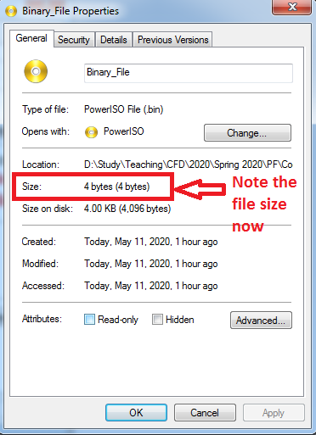
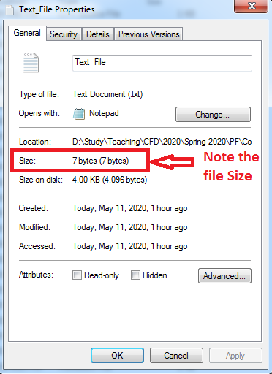
Writing the Data in Binary Format (2/2)
Suppose that we are writing a float value (123.0625) in a text file and in a binary file
Have a look at the code “Text_and_Bin_file”
  In Binary file the size is 4 bytes
  And in text file the size is 7 bytes

Slide 10
Reading the Data in Binary Format (2/2)
To read the data from binary file we first open the file in ios::in|ios::binary mode
Then to read the data we use read() function
It extracts a given number of bytes (2nd argument) from the given stream and place them into the memory, pointed to by the first parameter
Have a look at the file named “Binary_read”

Slide 11
Writing an Object to File
When writing an object, we generally want to use binary mode
This writes the same bit configuration to disk that was stored in memory, and ensures that numerical data contained in objects is handled properly
Have a look at the file named “writing_objects_to_file”

Slide 12
Reading an Object from File
Reading the object from a file requires the use of read() function
Have a look at the file named “reading_object_from_file”
As the binary file format takes the number of bytes (size of object) as argument, so in order to keep the size fixed, we use c-strings instead of string objects if we want to read/write objects to the file

Slide 13
Reading and Writing Multiple Objects
Multiple objects can be written on a file at once
A do-while loop can be used to ask the user to enter the data for several objects
Inside the loop each object can be written to file
Then while reading the objects from file, one object is read at a time until end-of-file is reached
Have a look at the file named “Read_write_multiple_objects”

Slide 14
Objects that Read/Write Themselves
If we want to automatically read/write the objects then we add read() and write() as member functions in the class
And we call the member functions for input() and display inside the body of write() and read() functions
Have a look at the file named “Auto_Read_Write_Objects”

Slide 15
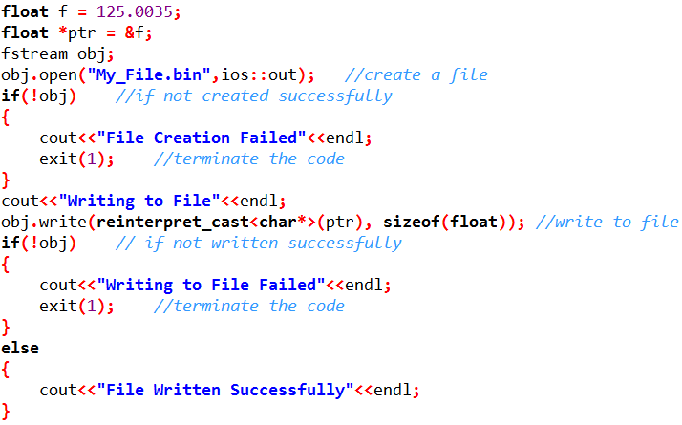
Error Handling in Files (1/2)
We can check the files for errors while creating, writing, opening and reading the files
The following code can be used to check the errors while creating the and writing to file
If there is any error then the program terminates

Slide 16
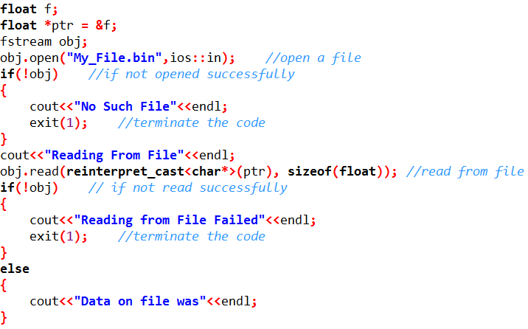
Error Handling in Files (2/2)
The following code can be used to check the errors while opening and reading from file
If there is any error then the program terminates

Slide 17
Analyzing the Errors (1/2)
In the previous examples we determined whether an error occurred in an I/O operation by examining the return value of the entire stream object
  if(!obj)
  // error occurred
Here obj returns a pointer value if everything went well, but 0 if it didn’t
This is the shotgun approach to errors: No matter what the error is, it’s detected in the same way and the same action is taken
However, it’s also possible, using the ios error-status flags, to find out more specific information about a file I/O error
The example on next slide will explain it further

Slide 18
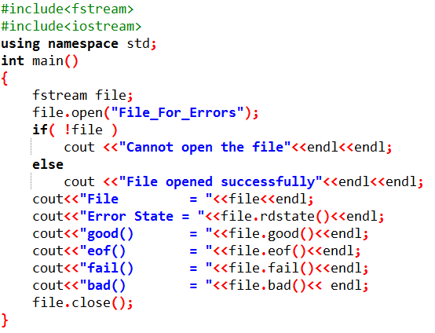
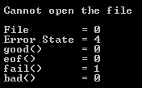
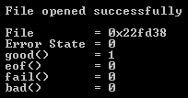
Analyzing the Errors (2/2)
This program first checks the value of the object file
If its value is zero, the file probably could not be opened because it didn’t exist
The error state returned by rdstate() is the bit that indicates that the file doesn’t exist; it’s set to 4
The good() function returns 1 (true) only when no bits are set, so it returns 0 (false)
We’re not at EOF, so eof() returns 0
The bad() will return 0 as there are no invalid operations
The fail() function return nonzero, since a fail error occurred
In case the file is available in the directory, then following values will display
In a serious program, some or all of these functions should be used after every I/O operation to ensure that things went as expected

